Slide 1
C++ No-SQL Database Web Framework
for Cloud-based Websites

Slide 2
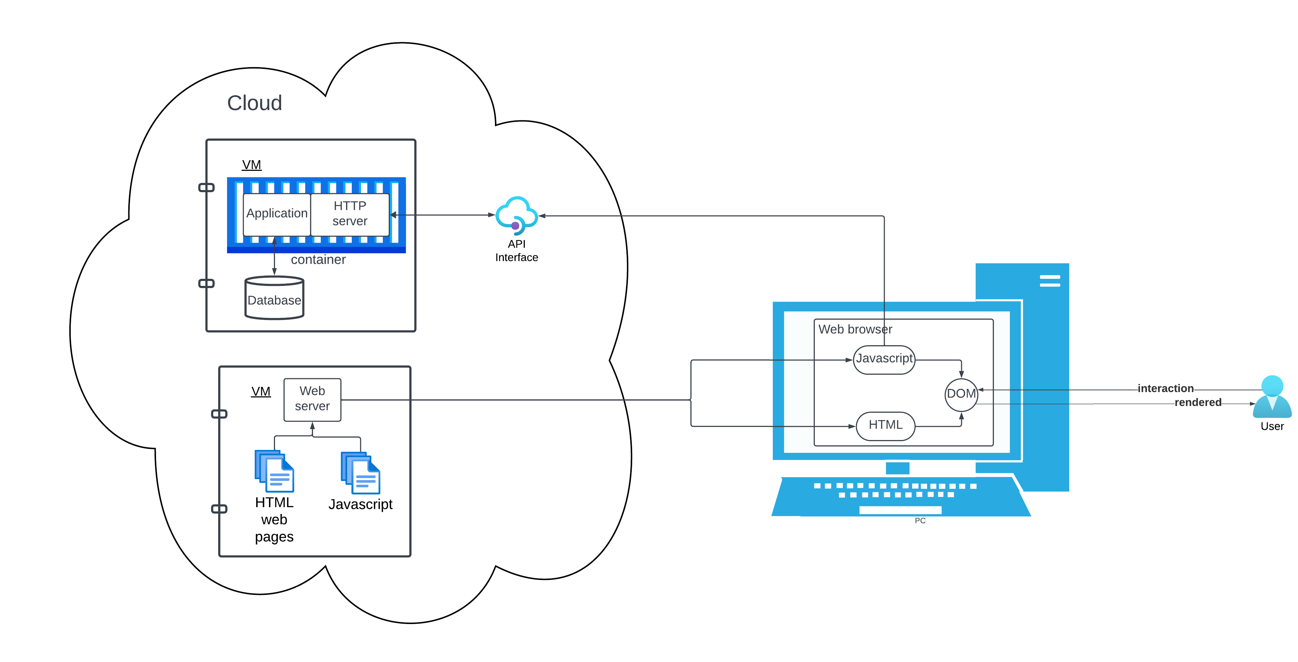
Web Application Anatomy

Slide 3
Web application breakdown
Cloud components
Application server virtual machine
Database application
HTTP API interface
Database
Web server virtual machine
HTML web pages
Javascript files
User components
Browser
HTML
Javascript/jQuery code
Domain object model

Slide 4
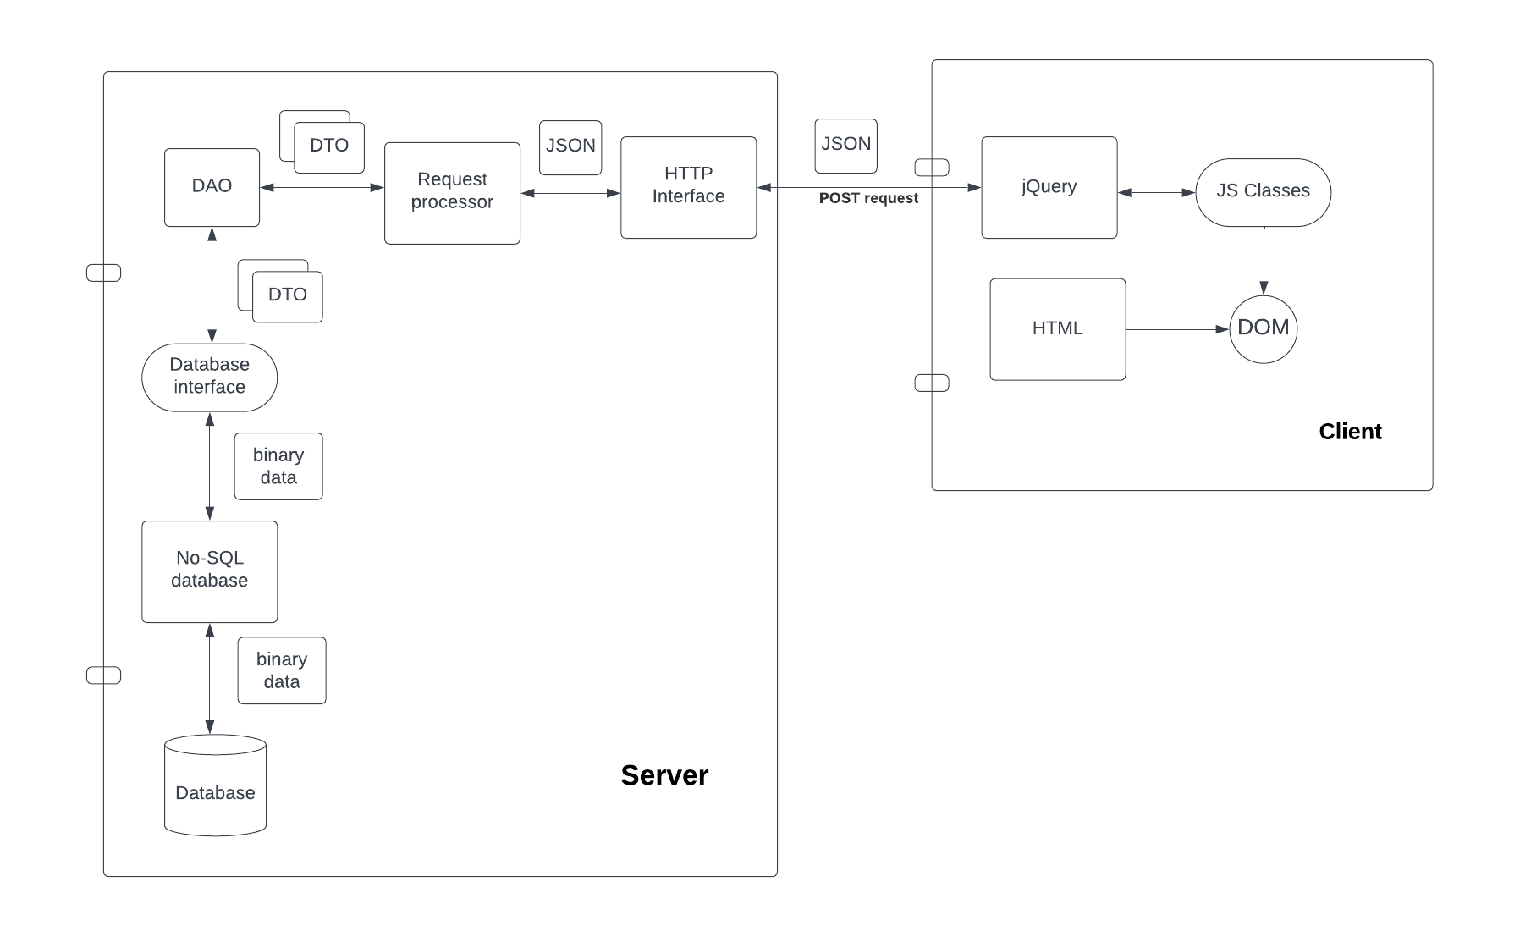
C++ Web Framework Architecture

Slide 5
Server and Client Components
Server components
HTTP interface
Receives and sends JSON POST requests and responses
Web request processor
Processes JSON application requests
Data Access Objects
Exchanges data transfer objects with database interface
Database interface
Serialize and deserialize DTOs to transfer as binary database data
No-SQL database interface
Provides indexed access to database records
Client components
HTML UI components
jQuery ajax calls
Javascript UI control classes

Slide 6
Other C++ Web Frameworks
Oat++ (oatpp.io)
Drogon (drogon.org)
POCO (pocoproject.org)
TreeFrog (www.treefrogframework.org)
Pistache (pistache.io)
Wt (Web GUI library https://www.webtoolkit.eu/wt)
CppCMS (http://cppcms.com/)

Slide 7
Comparison with this framework
The other frameworks:
Are more powerful
Have been in development longer
Provide a full set of web interface features
Advantages of this framework
Is much simpler
Integrates a database into the framework
Can more quickly create a full web application

